Slide 1

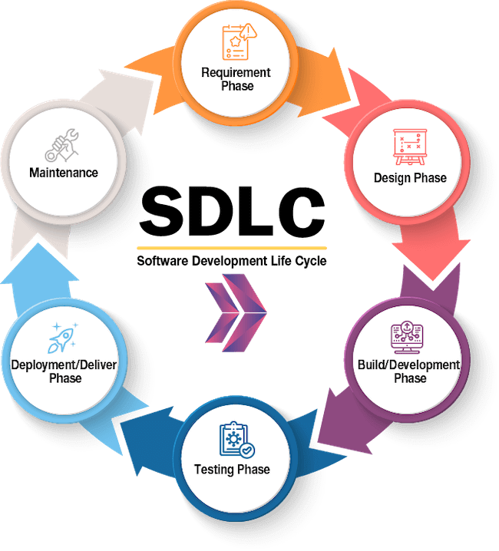
Scrum-Agile SDLC
by Simon Byelkin

Slide 2
Contents
Introduction
Roles
Phases
Waterfall SDLC
Waterfall vs. Agile

Slide 3

Introduction
Scrum is a project management framework that helps teams manage the development of their product.
It is an iterative and incremental model that emphasizes adaptability and responding to feedback
Each team member has their own role, and the development is done in sprints that are usually two weeks long
Not all companies or teams within those companies follow the traditional Scrum-Agile framework, it is very adaptable and can be modified to suit the needs of the team.
3

Slide 4




Roles in Scrum-Agile
Product Owner
Scrum Master
Developer Team
Testers
Responsible for defining the product vision and managing the backlog. Managing the backlog consists of:
Prioritizing tasks
Creating tasks from user feedback
Removing tasks that are unnecessary
The role of Scrum Master is facilitating Scrum events, coaching the team, resolve any conflicts, prevent potential roadblocks throughout the sprint. Scrum Events:
Sprint Planning
Daily Scrum
Sprint Review
Consists of both UI/UX designers and backend developers. They are implementing the features that are prioritized in the backlog by the Product Owner.
They develop testing scenarios according to user stories in the backlog, design the tests, and provide feedback to the rest of the team.
4

Slide 5
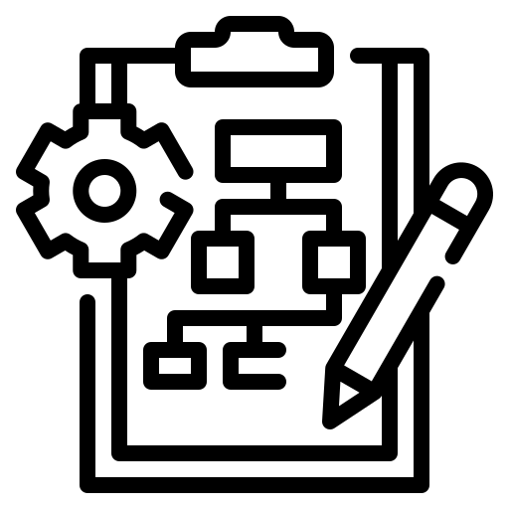
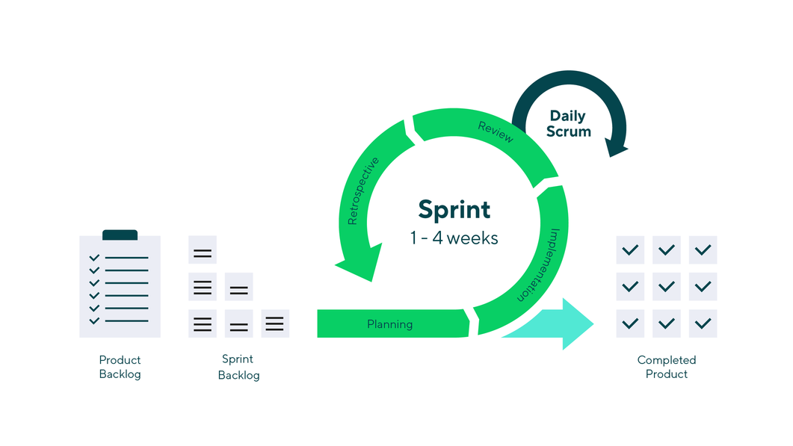



Phases
Planning
Product owner and developers work together to understand the requirements and creating the backlog.
Implementation/Sprint
The developers and other team members are working on implementing the features defined in the backlog.
Review
Team meets to review the work completed during the sprint. The PO proved feedback and backlog is adjusted.
Retrospective
The team reflects on the previous sprint and identifies areas for improvement.

Slide 6
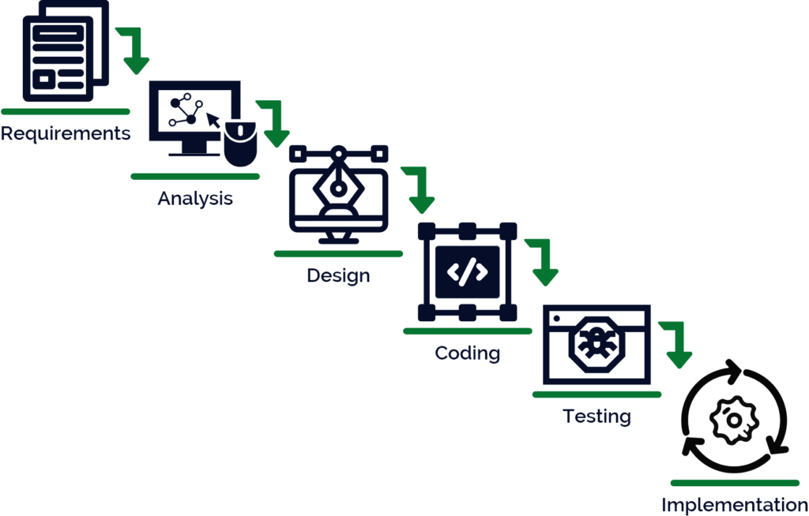
Waterfall SDLC
The Waterfall model is a traditional software development approach that follows a sequential, linear process. It consists of the following phases:
Requirements Analysis - In this phase, the project team identifies the project requirements and documents them in a requirements specification.
Design - In this phase, the project team develops a detailed system design based on the requirements specification.
Implementation - In this phase, the project team writes the code, integrates the software components, and tests the system.
Testing - In this phase, the project team conducts various types of testing to ensure that the system meets the requirements.
Deployment - In this phase, the project team installs the system in the production environment and releases it to the users.
The Waterfall model assumes that the requirements of a project can be clearly defined and documented upfront, and that the development team can then follow a predictable and linear process to implement the solution. This approach is often used for projects with well-defined requirements and a stable environment.

Slide 7
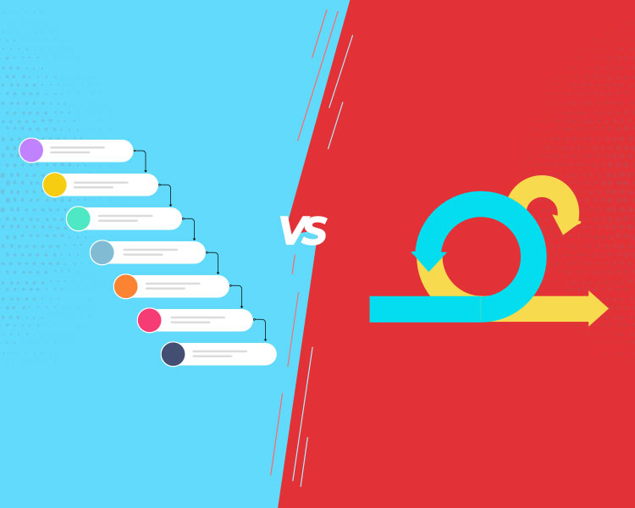
Scrum-Agile Vs. Waterfall
Scrum-Agile
Waterfall
Follows an iterative and incremental model
Emphasizes adapting to change and responding to feedback
Agile phases may overlap
Uses short sprints
Employs a self-organizing team with clearly defined roles
Follows a sequential and linear model
Requires extensive planning and documentation upfront
A phase must be completed before the start of the next one
Minimal customer involvement during development
Testing is typically done as the last phase before release
What to consider when choosing for your project?
Project size and complexity, Waterfall is better for smaller project with a clear vision
Customer involvement and collaboration, Agile is better for high customer involvement
Flexibility and adaptability to change, Agile is better for rapidly changing environments
Development team, the abilities of the developers and how well they know each other and how clear their roles are defined, Waterfall can work well in well established teams of experienced developers and product managers.

Slide 8




Thank you and Slava Ukraine!

Slide 9
Bibliography
Waterfall model (software engineering) - javatpoint. www.javatpoint.com. (n.d.). Retrieved February 26, 2023, from https://www.javatpoint.com/software-engineering-waterfall-model
Hoory, L. (2022, August 10). Agile vs. waterfall: Which project management methodology is best for you? Forbes. Retrieved February 26, 2023, from https://www.forbes.com/advisor/business/agile-vs-waterfall-methodology/
What is Scrum? Scrum.org. (n.d.). Retrieved February 26, 2023, from https://www.scrum.org/resources/what-is-scrum

